Slide 1







Capstone Project - The Battle of Neighborhoods
HUAN CHEE WEI
05 MAY 2021

Slide 2



OUTLINE
Executive Summary
Introduction
Methodology
Results
Visualization – Charts
Dashboard
Discussion
Findings & Implications
Conclusion
Appendix

Slide 3

EXECUTIVE SUMMARY
Point1
Point2
Sub Point 1
Sub Point 2
Sub Point 3
Point3
Point4
Point5

Slide 4

INTRODUCTION
BACKGROUND
Looking for location for restaurant and contractor business in Manhattan city
Problem
no clue how many restaurants and contractor firm available in which neighborhoods
Interest
find out the number of restaurants and their location. Then find out the same for contractor firms. It will be good if both can set up nearby

Slide 5

METHODOLOGY
Data source: obtained from Coursera sample data, it is a json file
Data Cleaning & Feature Selection: obtained coordinates for the borough in New York city, There are 5 boroughs and 306 neighborhoods in total, and we only use the coordinate for Manhattan city.

Slide 6
RESULTS
Based on the analysis, Roosevelt Island is the best location for restaurant business and contractor’s firm. Because there is only 1 restaurant and no contractor firm in the neighbourhood

Slide 7
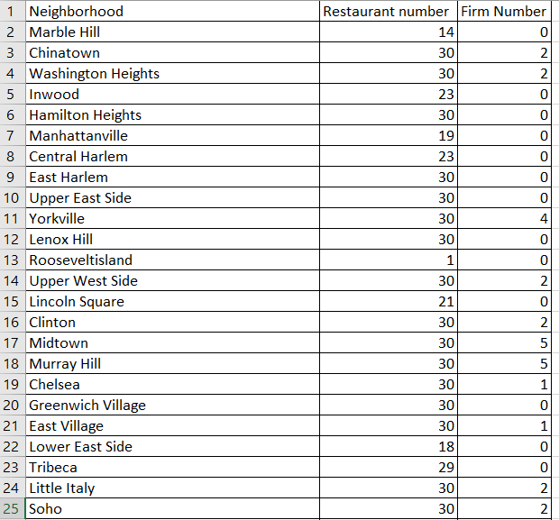
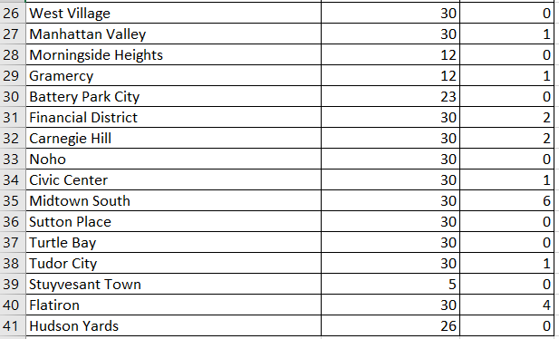
Total Number of Restaurant

Slide 8

DASHBOARD
https://github.com/scotthcw/Coursera_Capstone/blob/01d570b08b46c3ff95f309da01c8ad81c8668844/Peer_graded_Assignment_Capstone_Project_The_Battle_of_Neighborhoods_(Week_1).ipynb

Slide 9
DISCUSSION
Based on the analysis, there are few neighborhoods are good for restaurant and firm. For example, Stuyvesant Town has only 5 restaurants and 0 firm; Morningside Heights has 12 restaurants and 0 firm

Slide 10

CONCLUSION
Even though Manhattan city is well developed but there are still some areas are good for development and businesses. The areas mentioned above, Roosevelt, Stuyvesant Town and Morningside Heights are good location for new restaurant and firms.

